Slide 1
2016 New York Rat Sighting Exploration

Slide 2
Task
I have been hired by the State of New York to resolve the rat infestation which plagues the city. As a data analyst I am working alongside the exterminators in order to come up with an effective plan to resolve the issue.

Slide 3


1. Intro
Each year the city of New York publishes the 311 calls to the public. Contained in these calls are reports of rat sightings.
How can the data help? The data can help us focus on certain areas, times and environment which will give us the best rate of success to resolving the issue in a timely manner..
Emotional We are able to identify from the data and use of machine learning algorithms the effect/ importance of different types of features that leads to more rat sightings.

Slide 4


Data Collection:
2 Datasets where used in our analysis
Rat sighting data from New York’s 311 Portal via Kaggle
https://www.kaggle.com/new-york-city/nyc-rat-sightings
Data was downloaded as CSV, uploaded to Github and imported into Jupyter Environment as a Pandas DataFrame.
Historical Weather Data from DarkSky API
https://darksky.net/dev
Data was pulled from DarkSky API as JSON. It was then converted into Pandas DataFrame

Slide 5

Challenges:
Finding the data was easy, accessing the data was the trouble
Number of pulls from API per a day
Ensuring that data was properly cleaned and formatted to achieve a proper merge and statistical analysis
DateTime data type
If we had more accessible information regarding litter information in New York State, we would have been able to uncover more interesting patterns

Slide 6
Data Preparation

Slide 7
Data Merging:
The Rat Sightings data and Historical Weather data were merged on the Date feature. What resulted was a dataframe of multiple sightings per a day and the daily weather for New York on that day.

Slide 8
Missing Data:
Before:
The original Rat Sighting Data was missing data in the form of entire columns or partial columns.
After:
Mandatory data was not affected by missing data
Notes:
We resolved this issue by dropping any column which was completely empty using the above function.
Once we cleaned out most of the mess we were able to see that the mandatory columns we needed weren’t missing any data and therefore the missing data would not impact our analysis

Slide 9
Creating Dummies:
Borough had to be converted from qualitative to quantitative in order to properly fit a regression model.

Slide 10
EDA:
Exploratory Data Analysis

Slide 11
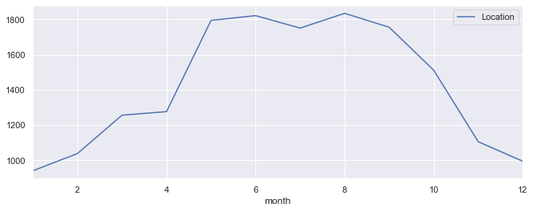
Time series: Reported Sighting Over the Year
The time series plot maps the number of sightings over the course of the 2016 year. The data seems to indicate that between May and September the highest number of sightings occur. Perhaps this has something to do with the weather and these months having warmer weather than the others.

Slide 12
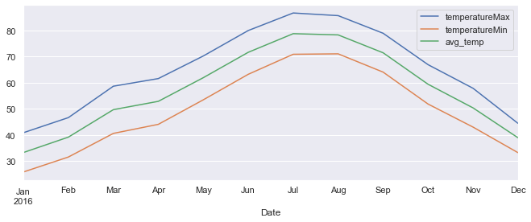
Time Series: Max, Min and Average Temperature Throughout the months
As stated before the months between May and September have the highest Max, Min and Average temperatures compared to the rest of the year.

Slide 13
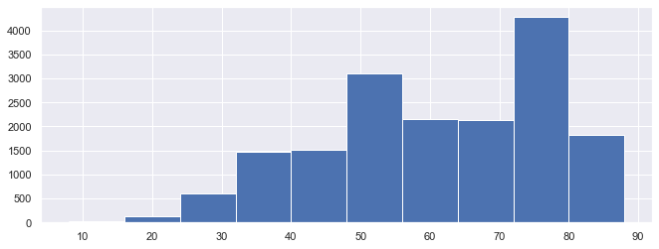
Histogram: Average Temp
Based on the histogram it appears that as Temperatures rise, the number of reported sightings also rise, further backing our theory that warmer temperatures lead to more rat sightings.

Slide 14
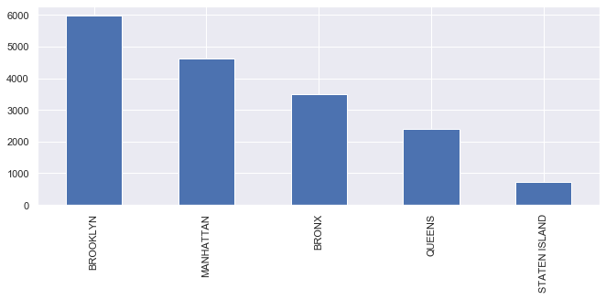
Bar Plot: Reported Sightings Per Borough
Brooklyn has the most reported sightings of rats

Slide 15
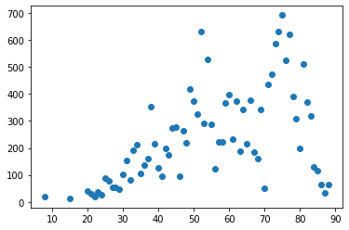
Scatter Plot:
Average Temperature vs. Number of Sightings
There appears to be a weak positive relationship between Temperature and Number of Sightings.
Notes:
When the temperature is low the relationship appears to be stronger, but as temperature rises the data becomes more spread out.

Slide 16
Modeling:

Slide 17
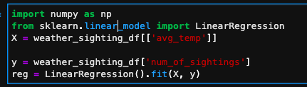



Simple Linear Regression Model: Effect of Weather on Number of Rat Sightings
Use machine learning techniques to identify the effect of weather on number of sightings
R²:
Coefficient:
Intercept:

Slide 18
The goodness of fit, between 0 and 1. The goodness of fit for this model is 26.44%.
Only 26.44% of variance in number of sightings is explained by the avg_temperature variable. Temperature is not a very good estimator for number of sightings.
With a degree increase in temperature the number of sightings in New York increases by 3.92 units.
When there is Zero degree temperature the number of sightings in New York State is 10.6 as per the data.

Slide 19
Bar Plot: Reported Sightings Per Borough
Brooklyn has the most reported sightings of rats

Slide 20
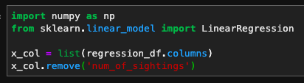




Multiple Linear Regression Model: Effect of Weather and Borough on Number of Rat Sightings
Use machine learning techniques to identify the effect of weather and Borough on number of sightings
R²:
Coefficient:
Intercept:

Slide 21
41% of variance in number of sightings is explained by both borough and temperature variables. Where as only 26% of variance was captured by merely using only average temperature. Which indicates that the number of sightings also depends on borough.
All these variables are not correlated with each other because all the weather data is the same for any location in New York.
When the temperature is 0 and the borough is Bronx the number sightings is 1.5.

Slide 22
Suggestions and Recommendations:
Based on our analysis we conclude that the best time to put our plan into action can be concluded from the data. We believe that the sighting are higher during the hot seasons in certain locations within New York. This was concluded from the Linear Regression Equations.
We believe that terminators should focus on these locations (Brooklyn and Manhattan) during the hot periods of the year in order to optimize their results.

